Slide 1
Client DB Management System
Client: Rium Salon
Junseo Yang
Start Date: 2021-06-02

Slide 2
Rium Salon Coiffure Client DB Management System v1
Listbox Nav
Client ID
Profile Pic
Name
Phone
E-mail
Notes
Clear
Save
Cancel
Delete
Control Visit History Manually
ID
Search
Location
Service
Price
Worker
Date
Start
End
Status
Special
Request
Clear
Save
Cancel
Delete
View Visit History
ID Location Service Price Worker Date Start End Special-Request

Slide 3
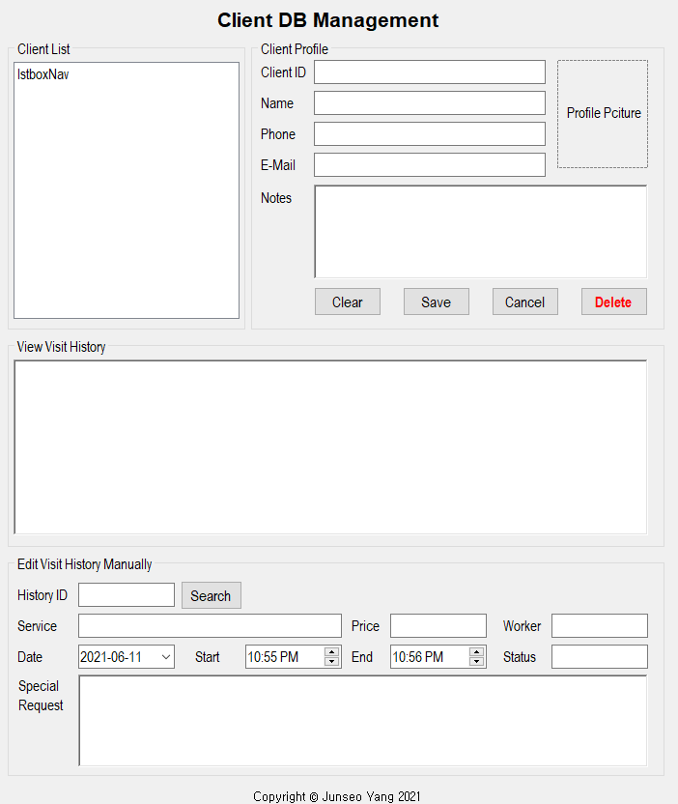
Rium Salon Coiffure Client DB Management System v2

